Slide 1
SOUND DETECTION
Submitted to : Prof Vittorio Scarano

Slide 2
PROBLEM AREA
Nowadays, a lot of security events are initiated due to some sort of sound which includes gunshots, aggressive behavior, breaking the glass. But cameras with inbuilt sound exposure facilities can add huge value to the security system. Because they give an alert automatically when real and potential incidents occur. Then immediately they activate quick and appropriate actions to reduce the consequences

Slide 3
PURPOSE
The main focus of this study to address the previously mentioned problems is to detect and monitor sound which plays vital role in our daily life that includes human security and also hazardous for human health, therefore the purpose of this project is to detect and sense sound and monitor those values on an independent platform. By using ky-037 sensor we can get notified timely which can ease daily life of people related to health and deeply involve in daily chores.

Slide 4
01
TOOLS

Slide 5
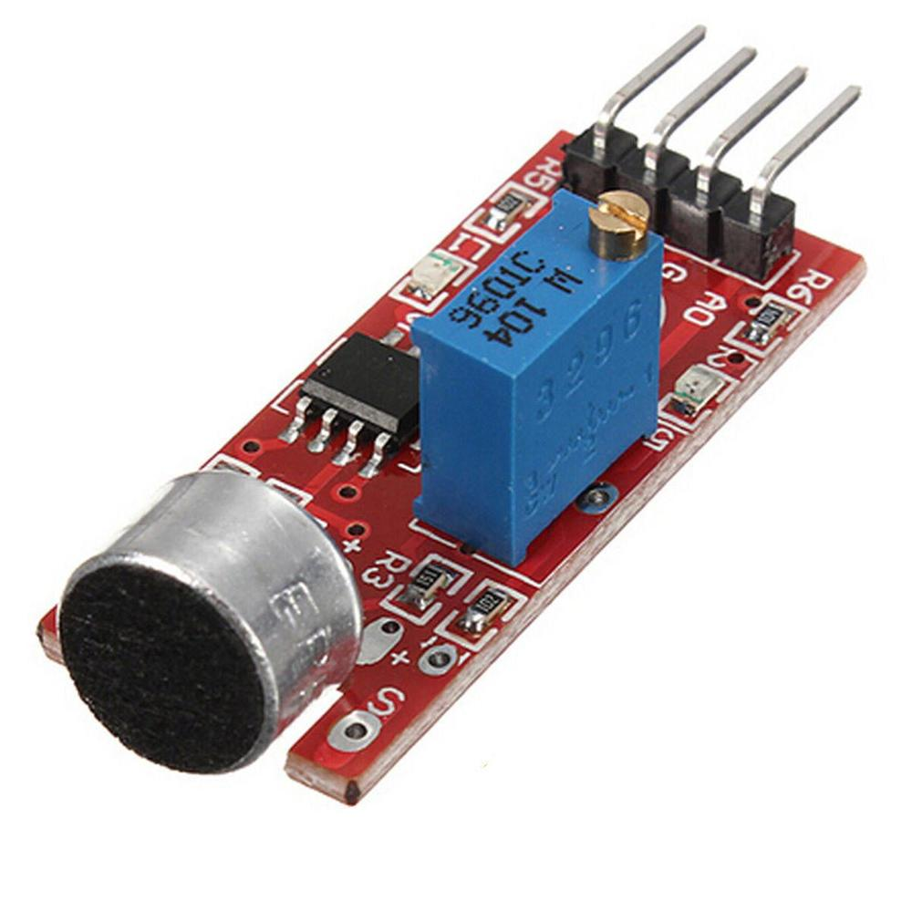
SOUND SENSOR KY-037
Sound sensor is defined as a module that detects sound waves through its intensity and converting it to electrical signals. This sensor can be easily interfaced with any micro-controller such as Arduino, Raspberry Pi etc.

Slide 6
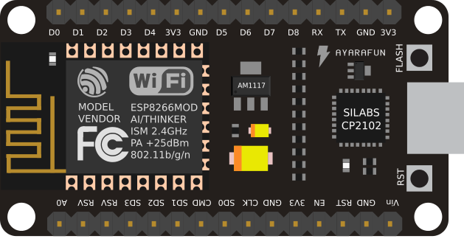
NODE MCU
is a low-cost open source IoT device that includes firmware, which runs on the ESP8266 Wi-Fi microchip, and hardware based on the ESP-12 module. NodeMCU has 128 KB RAM and 4MB of Flash memory to store data and programs.This device consists of 13 GPIO pins.

Slide 7


RABBITMQ
is a low-cost open source IoT device that includes firmware, which runs on the ESP8266 Wi-Fi microchip, and hardware based on the ESP-12 module. NodeMCU has 128 KB RAM and 4MB of Flash memory to store data and programs.This device consists of 13 GPIO pins.
NUCLIO
Nuclio is an open source and managed serverless platform used to minimize development and maintenance overhead and automate the deployment of data-science based application

Slide 8
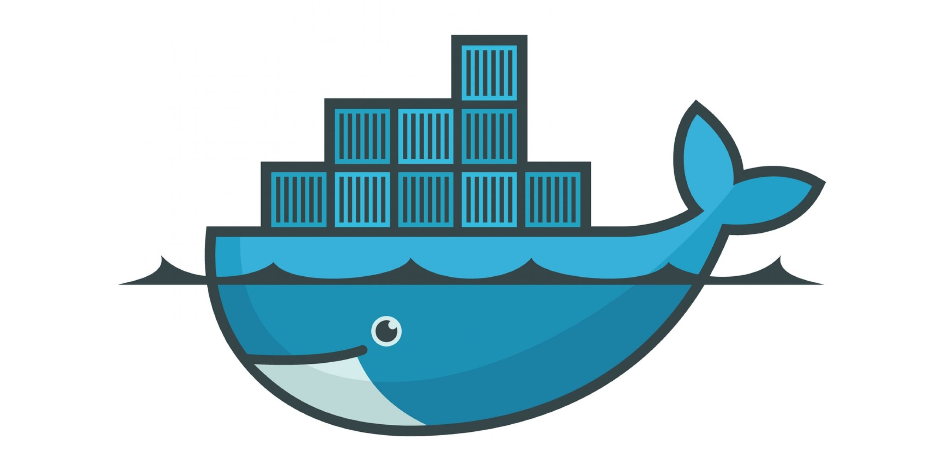
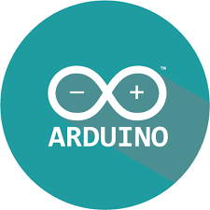
DOCKER
ARDUINO
Docker is a open source project that automates the process of deployment of applications in software containers.
Development Environment is a cross-platform application that is written in functions from C and C++. It is used to write and upload programs to Arduino compatible boards such as NodeMCU.

Slide 9
LIBRARIES
02
01
Pubsubclient
Is a client library for MQTT messaging, MQTT is a lightweight messaging protocol ideal for small devices. This library allows you to send and receive MQTT messages.
ESP8266
is the library support for the ESP8266 chip to the Arduino environment. It lets us write sketches, using familiar Arduino functions and libraries, and run them directly on NODEMCU

Slide 10
IN DEPTH
01
03
02
UBUNTU
Firstly we install UBUNTU 18.04 on a Virtual Machine
NUCLIO
After Installing docker then we have to install Nuclio serverless platform by using the docker command.
DOCKER
Then we install Docker and Docker Compose on the Ubuntu.

Slide 11
IN DEPTH
04
06
05
RABITMQ
Then we move towards installing RabbitMQ by using the given Docker command.
LIBRARIES INSTALLATION
Installing the library for connecting the sensor.
ARDUINO IDE
Downloading the Arduino IDE to upload the code to NODEMCU.

Slide 12
IN DEPTH
07
09
08
CODE UPLOADING
Before Uploading the Code we must install MQTT library PUBSUBCLIENT and then we install ESP8266 library for NODEMCU and finally we upload the Code
RABBITMQ
The deployed function on Nuclio will generate queues on RabbitMQ of the data sensed from the sensor.
DEPLOY THE FUNCTION ON NUCLIO
To generate the queues on RabbitMQ first we deploy the given function on Nuclio by setting IP and triggers.

Slide 13

APPLICATIONS
Apart from building various electronic projects with Arduino and sound sensors are used in many other day to day applications including:
- Consumer electronics such as phones, computers, music systems.
- Security and Monitoring systems such as burglar alarms, door alarm, etc.
Home automation such as lighting your house by detecting whistle/clap instead of physically turning the light switch.
Ambient sound recognition and sound level recognition

Slide 14
THANKYOU PROFESSOR !

